Slide 1
The Gospel of Yehuda of Galilee
Truly you have heard it said, but I say unto you

Slide 2
Why do I call him Yehuda of Galilee?
I believe the author of Luke and Acts was Plutarch, and this is also something the elite know and hide in plain sight. For example, in the film and play, “seven brides for seven brothers” the main female lead says her father gave her, “Plutarch and the Bible, you can find out everything you need from reading them.” The style he employed is called allegory, where by reading Plutarch’s writings and Luke/Acts you can have an additional layer revealed of what the author is trying to share with us. Many Christians do not want to acknowledge the esoteric mystery religion hidden in plain sight within the NT.

Slide 3
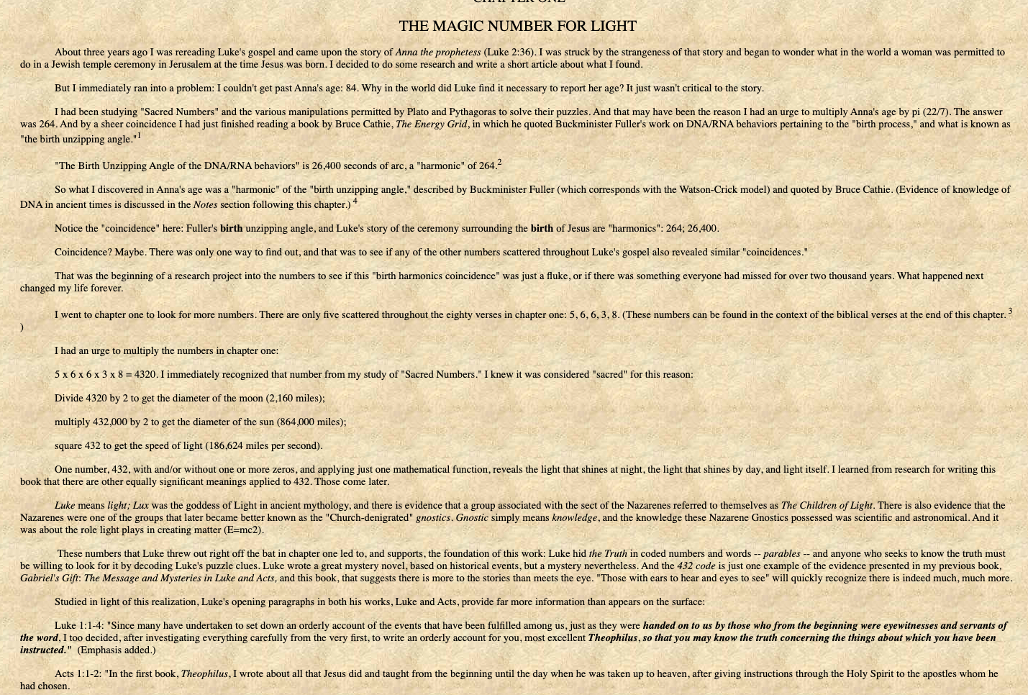
The hidden message of Luke

Slide 4
What I believe Father showed me about the true identity of Yeshua
[Luk 13:1-2 LSB] Now at that same time there were some present who were reporting to Him about the Galileans whose blood Pilate had mixed with their sacrifices. And Jesus answered and said to them, "Do you think that these Galileans were [greater] sinners than all [other] Galileans because they suffered these things?
[Act 5:36-37 LSB]"For some time ago Theudas (Thomas) rose up, claiming to be somebody, and a group of about four hundred men joined up with him. But he was killed, and all who were following him were dispersed and came to nothing. "After this man, Judas (Yehudah) the Galilean rose up in the days of the census and drew away people after him. He too perished, and all those who were following him were scattered.

Slide 5
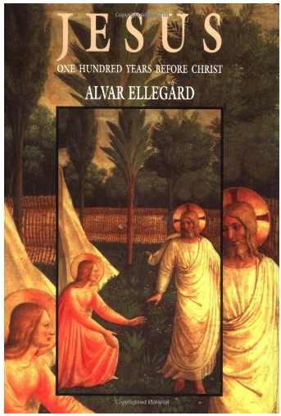
This is also not private interpretation - others have come to the same conclusion
The Slavonic Josephus also ties the Temple-cleansing Judas to Judas the Galilean, mentioned by Josephus in 6 CE, at the Census of Cyrenius. The Temple-cleansing Judas preached a great reverence for the law and zeal in the face of torture. This is exactly equal to the teachings of Judas the Galilean. So this lone passage tells us that Judas was Judas the Galilean, that he came from a large family with several brothers, and the placement of the text at the Golden Eagle Temple Cleansing brings the "Jesus" movement back a generation, to 4 BCE.
From:
https://judasthegalilean.weebly.com/judas-the-galilean.html

Slide 6
In order to understand the present, including our bible —
We have to study history, and it’s sad the Protestants removed history (The Maccabees) from their Bible. The Maccabees help set the stage for what happened in the first century, and I’ve talked about before how that includes the idea of a righteous man dying for your sin.
2 Maccabees 12:43 He also took up a collection, man by man, to the amount of two thousand drachmas of silver, and sent it to Jerusalem to provide for a sin offering. In doing this he acted very well and honorably, taking account of the resurrection. 44 For if he were not expecting that those who had fallen would rise again, it would have been superfluous and foolish to pray for the dead. 45 But if he was looking to the splendid reward that is laid up for those who fall asleep in godliness, it was a holy and pious thought. Therefore he made atonement for the dead, that they might be delivered from their sin.
Yehuda didn’t intend to atone for the sin of mankind, this became the later narrative of his mission as it was for those who died against the wicked greek empire, standing up for YHWH and his Torah. This is one of the many reasons I completely discount the words in John’s Gospel, it’s an esoteric narrative telling us why a man had to die for sin. To violate Torah to free us from Torah, to deliver us the gospel of Grace and Truth straight from Paul.

Slide 7
Decoding the truth, why did he come
[Luk 2:1 LSB] Now it happened that in those days a decree went out from Caesar Augustus for a census to be taken of all the inhabited earth.
The reason for this is to point us back to Yehudah later on. The Roman Catholic church removed the history of Yehudah from the writings of Josephus to hide the truth. Yehudah is known as a teacher of the “new way” he resisted Rome, and the establishment Jews and was crucified by the Romans for fear of starting a rebellion against the establishment alliance between the Romans and the Jews. Remember the prior slide, I was talking about the historic importance of Maccabees. When the Greeks defiled the temple, the Maccabees chose instead of praying for YHWH to bring deliverance that they would seek deliverance from the Roman empire and from that moment onward the establishment Jews were allied with Rome.

Slide 8
The radical teachings in the oldest manuscripts
The oldest manuscript we have is Mark’s gospel. Mark’s gospel doesn’t have Jesus dying for sin, it doesn’t even have a resurrection account beyond verse 9 of chapter 16. It doesn’t have Jesus saying we must have faith in him. It doesn’t have the virgin birth, and it doesn’t even talk about what Jesus did in his childhood. What then does it teach that Matthew and John added on to?
Yehudah’s sayings are captured within it, and these are an allegory of why he came, why he died and why Jerusalem was destroyed.

Slide 9
Once you know what to look for, you’ll know what was added by the Greeks.
Yehudah would have understood scripture and wouldn’t have misquoted it the way the compiler who finalized Mark, Matthew, Luke and John did repeatedly. This starts right away.
[Mar 1:2-3 LSB] As it is written in Isaiah the prophet: "BEHOLD, I SEND MY MESSENGER AHEAD OF YOU, WHO WILL PREPARE YOUR WAY; THE VOICE OF ONE CRYING IN THE WILDERNESS, 'MAKE READY THE WAY OF THE LORD, MAKE HIS PATHS STRAIGHT.'"
The author is misquoting Isaiah 40 about Yohan (John) the immerser (baptist). Isaiah 40 is not about John, or Jesus.

Slide 10
Isaiah 40 - in context and explained
[Isa 40:1 LSB] "Comfort, O comfort My people," says your God.
Isaiah is the speaker, in context providing comfort for his people who have been displaced to Babylon. (and I will be going over this in a future study) Isaiah 40 - 60 are about the Babylonian exile. Not the first century, and not about now. Isaiah the Prophet was providing comfort for a people displaced from their homeland - which doesn’t make sense that Yohan/John would be the one providing comfort when Israel was a nation within Rome. They hadn’t yet been destroyed.
This is of course another problem with the misquotation in Mark, that Matthew, Luke and John all copied. This passage is about Israel being restored and the message of the gospels is about Jerusalem being imminently destroyed!

Slide 11
Inversed reality and confused messaging
[Isa 40:5 LSB] Then the glory of Yahweh will be revealed, And all flesh will see [it] together; For the mouth of Yahweh has spoken."
This passage is one of the passages I read and prayed about that made it clear the Messiah of the Greek New Testament, was not the messiah promised in the Torah and the Prophets. In fact, the secondary witness of Jeremiah makes this clear that Yohan could not have been this messenger.
[Jer 31:34 LSB] "And they will NOT teach again, each man his neighbor and each man his brother, saying, 'Know Yahweh,' for they will ALL know Me, from the least of them to the greatest of them," declares Yahweh, "for I will forgive their iniquity, and their sin I will remember no more."
The NT itself tells you that it is NOT the fulfillment of the renewed covenant, that Jesus commands them to “teach them all that I have taught you” (end of Matthew) and James declaring, “let not many of you be teachers.” The second century pseudepigrapha of John recognized this problem, and wrote in his second epistle that the Holy Spirit is our teacher. If this was true, we wouldn’t have antichrists declaring lies, and later on the need to “test the spirit” (1 Jo 4) as ALL FLESH will know the truth, and “they will ALL KNOW ME” - what the NT fundamentally as a whole teaches us then is impossible. If Jesus was the Messiah, there would be no antichrists, and there would be no one questioning this reality of Yah working through His “Son” in the way the NT claims.

Slide 12
Yehudah came to resist Roman rule
[Mar 1:15 LSB]and saying, "The time is fulfilled, and the kingdom of God is at hand; repent and believe in the gospel."
The word translated to Gott spell (gospel) is the greek word “evangelion” which is from Isaiah, and as I stated before was directed at Israel who was already in exile.
[Isa 52:7 LSB] How lovely on the mountains Are the feet of him who proclaims good news, (evangelion / gott spell) Who announces peace And proclaims good news of good things, Who announces salvation, [And] says to Zion, "Your God reigns!"
The context however of all of this section of Isaiah was written for an Israel that had been displaced to Babylon.

Slide 13
Peace I leave you?
John’s message is so different from the core of the synoptics that it should be obvious to even Christians that something is off, something is wrong. The truth is however, most of them don’t read the Bible - and therefore don’t really believe it.
For example, Jesus says this:
[Mat 10:34 LSB] "Do not think that I came to bring peace on the earth; I did not come to bring peace, but a sword.
This is because Yehudah (and this was a statement from him) was going to go and take down the Roman oppression of Jerusalem and Israel. However, John tells us this from supposedly the same man.
[Jhn 14:27 LSB] "Peace I leave with you; My peace I give to you; not as the world gives do I give to you. Do not let your heart be troubled, nor let it be fearful.
It’s simply not possible that both statements were spoken by the same man, unless Jesus whomever you believe he was, was a double-minded hypocrite.

